Slide 1
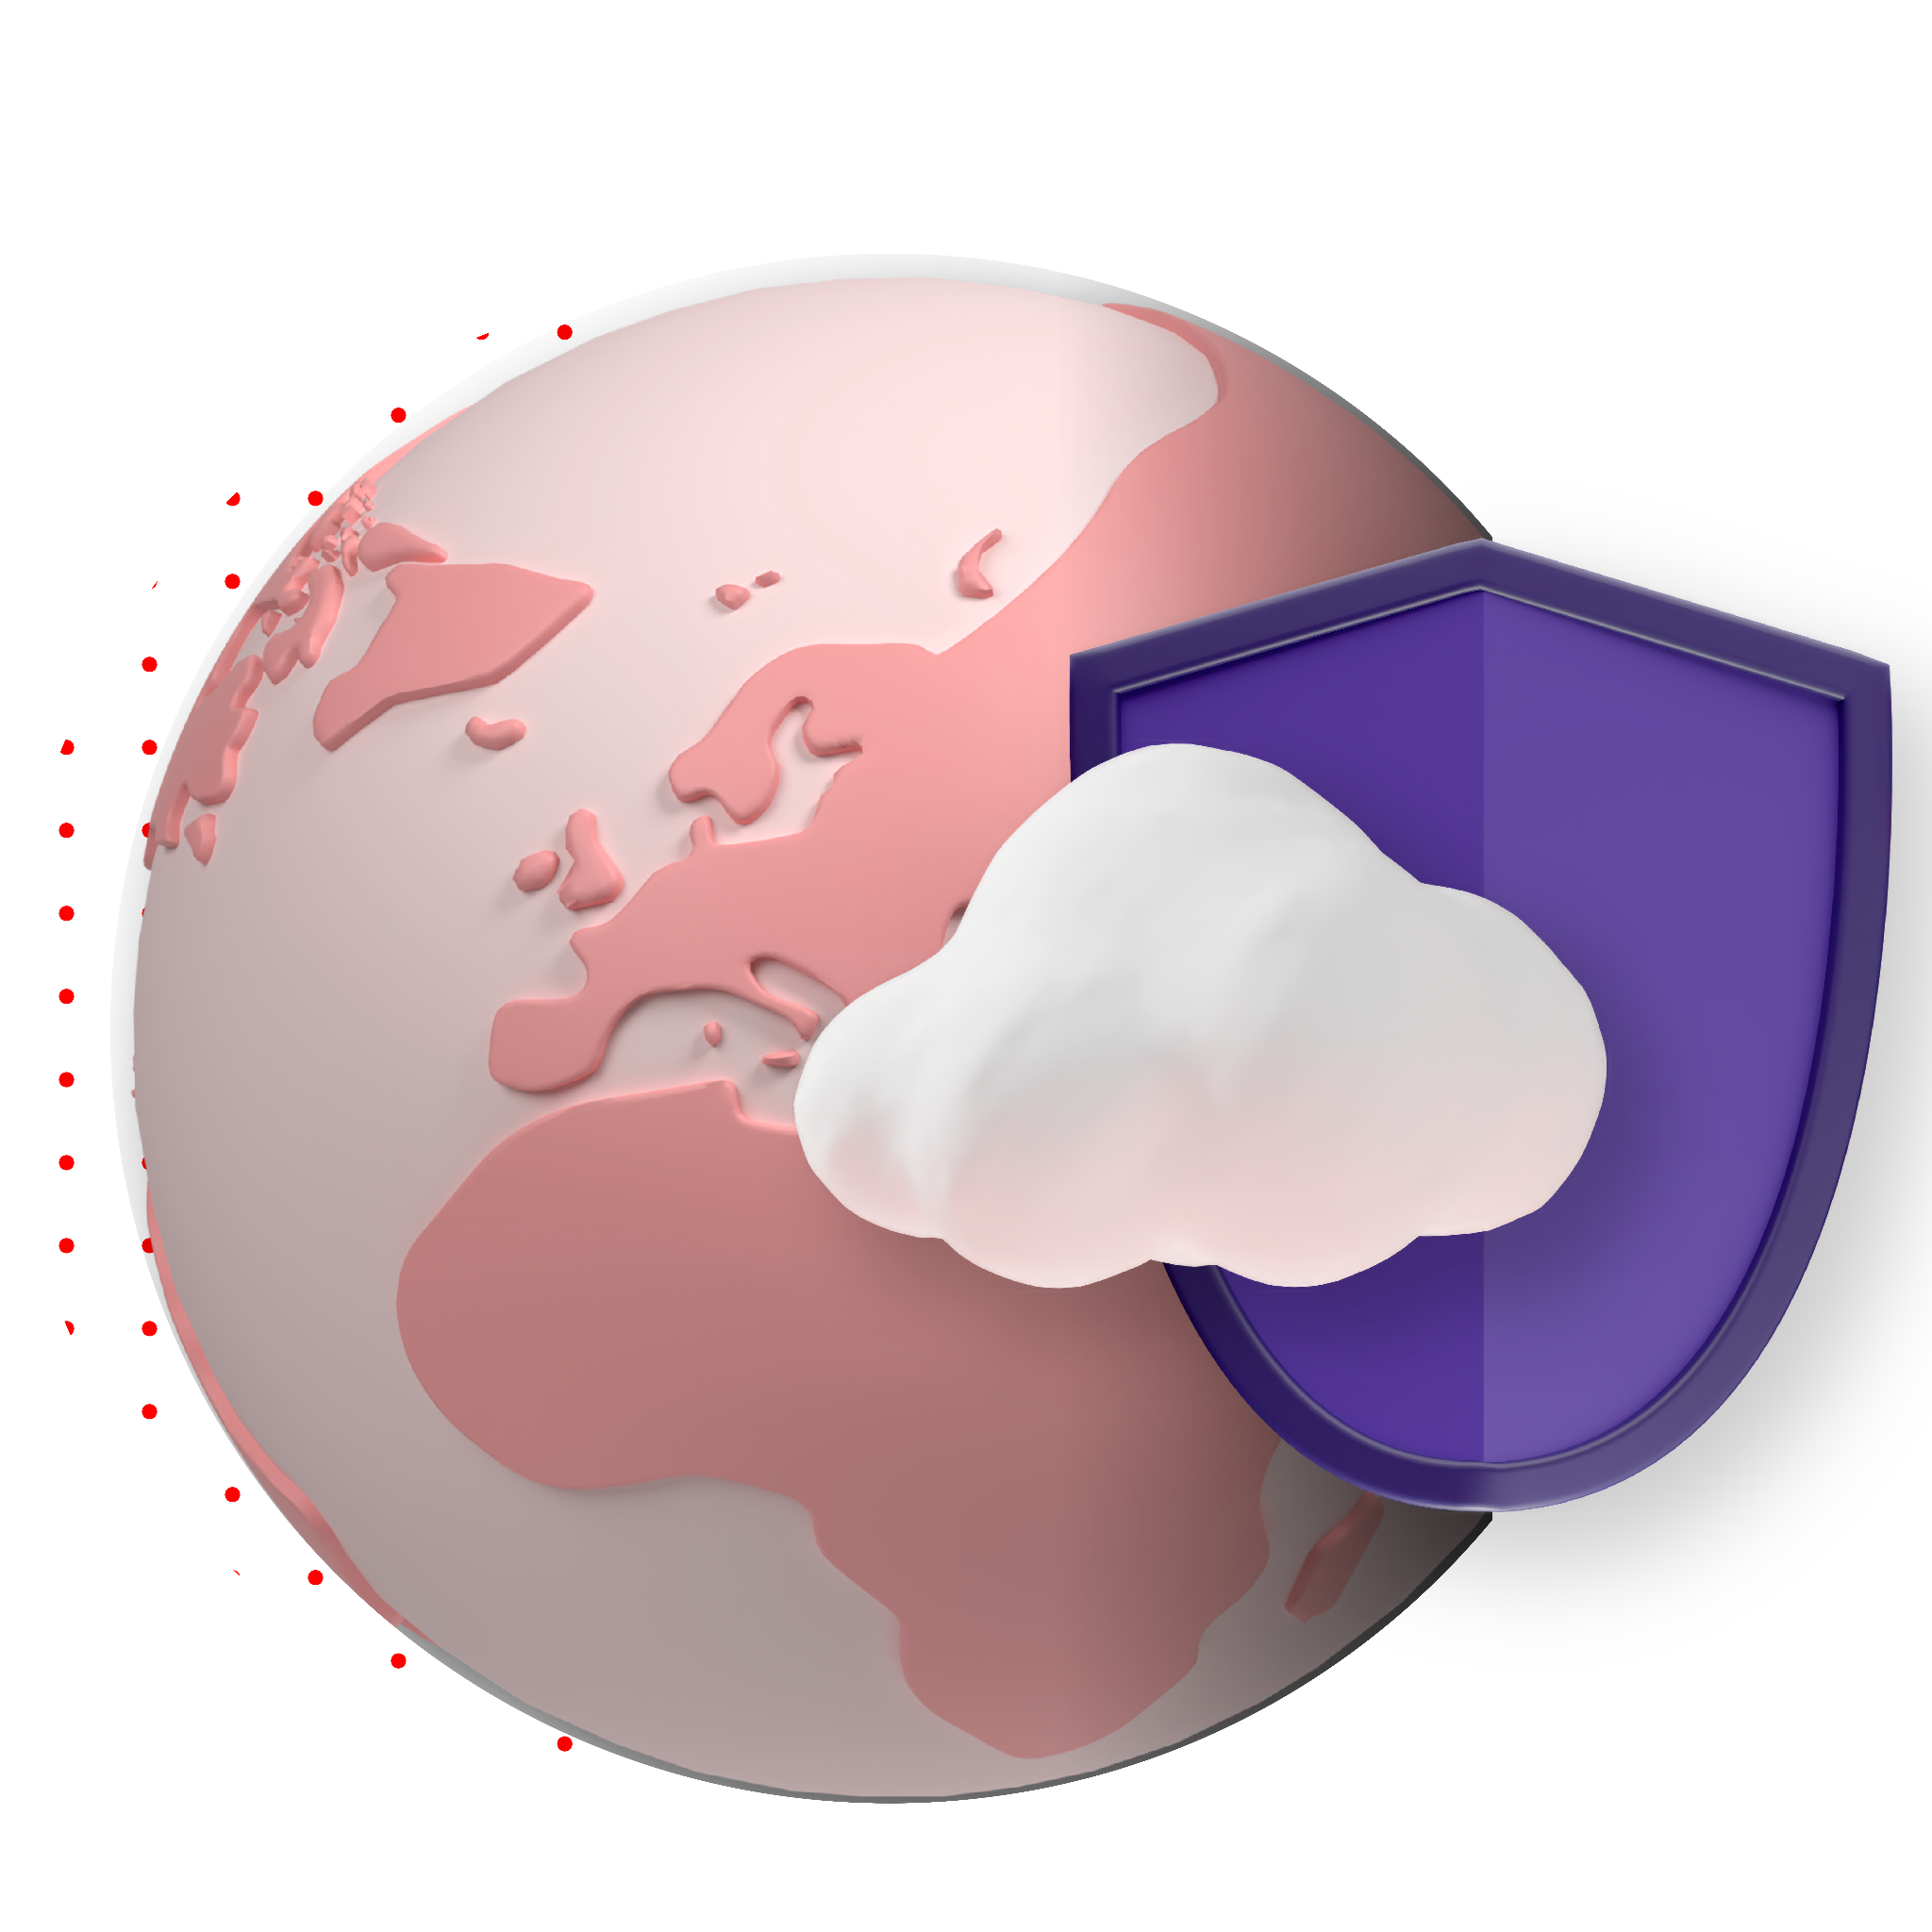
Seller Talking Points
Sovereignty

Slide 2


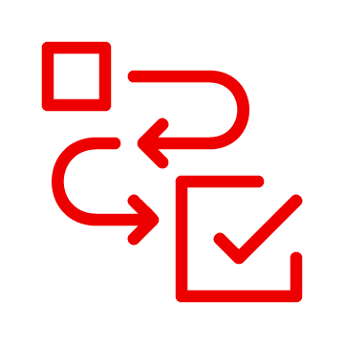

Sovereignty talk track and insights
Why have the Sovereignty conversation with your customer?
Rising global tensions increase the demand for technical independence and national self-sufficiency. Customers need to safeguard their critical infrastructure and intellectual property. Position Red Hat’s value of open source and transparency.
AI is shaping national policy and public trust. Customers must control AI data, models, security, and infrastructure in accordance with local laws. Red Hat AI platform enables customers to deploy AI where data lives - on-prem, in cloud or at the edge.
Changing global regulations (like GDPR, DORA, NIS2, and the AI Act) make sovereignty a legal requirement. Sovereignty concerns influence the choice of cloud vendor for a significant number of cloud decision-makers
Customer challenge summary
Sovereignty means many things, and each customer may focus on one or multiple challenges. The best strategy is to ask different discovery questions to get at the root challenge.
Vendor dependency
Trust and security
Technology and operational control
Organizations want solutions that reduce reliance on hyperscalers or proprietary technology stacks, enabling them to avoid vendor lock-in and easily migrate workloads. | Customers are concerned about the security of deployed technology, the risk of backdoors or hidden code, and seek clarity on what to expect from a US-based company regarding security. | Customers need technical and contractual proof that their data, applications, models, and hardware are exclusively subject to local law to prevent foreign legal intervention.
Our 4 key advantages
Transparency and auditability
Control and flexibility
Proprietary, "closed" technology stacks harbor hidden risks and vendor dependencies, threatening digital autonomy because they cannot be independently verified. Open source is the only credible path to digital sovereignty, offering the verifiable transparency needed to reduce hidden risk and confirm software is free from malicious code.
The Open Hybrid Cloud model ensures unparalleled control through deployment choice, allowing organizations to run applications consistently anywhere—on-premise, local partner clouds, or the edge. This ensures workload portability and the ability to adapt to regulatory changes.
Operational resilience and security
Local ecosystem and support
Red Hat enhances organizational resilience and protects critical infrastructure from disruption. Our platform provides comprehensive security, including workload protection, integration with External Key Management Systems (EKMS), and operational resilience through rapid disaster recovery.
Red Hat maintains a global ecosystem of local partners (CSPs, MSPs, etc.) essential for meeting specific jurisdictional and physical requirements. This is strengthened by offerings like Red Hat Confirmed Sovereign Support in the EU, providing dedicated support by verified EU citizens operating solely within the region.

